Slide 1
Hi School!
Connect the families to their school

Slide 2
Target
Customers: all educational establishment and their administrations.
Users: all people involved int school life (pupils, students and their parents, teachers, administration,…)

Slide 3
Why?
Too much channels of communication between parents and the school: emails, notes in the pupil's notebook, papers...
Challenges:
One app already exists but seems too expensive for most of establishments.
Find the potential improvements, new services, better design…

Slide 4
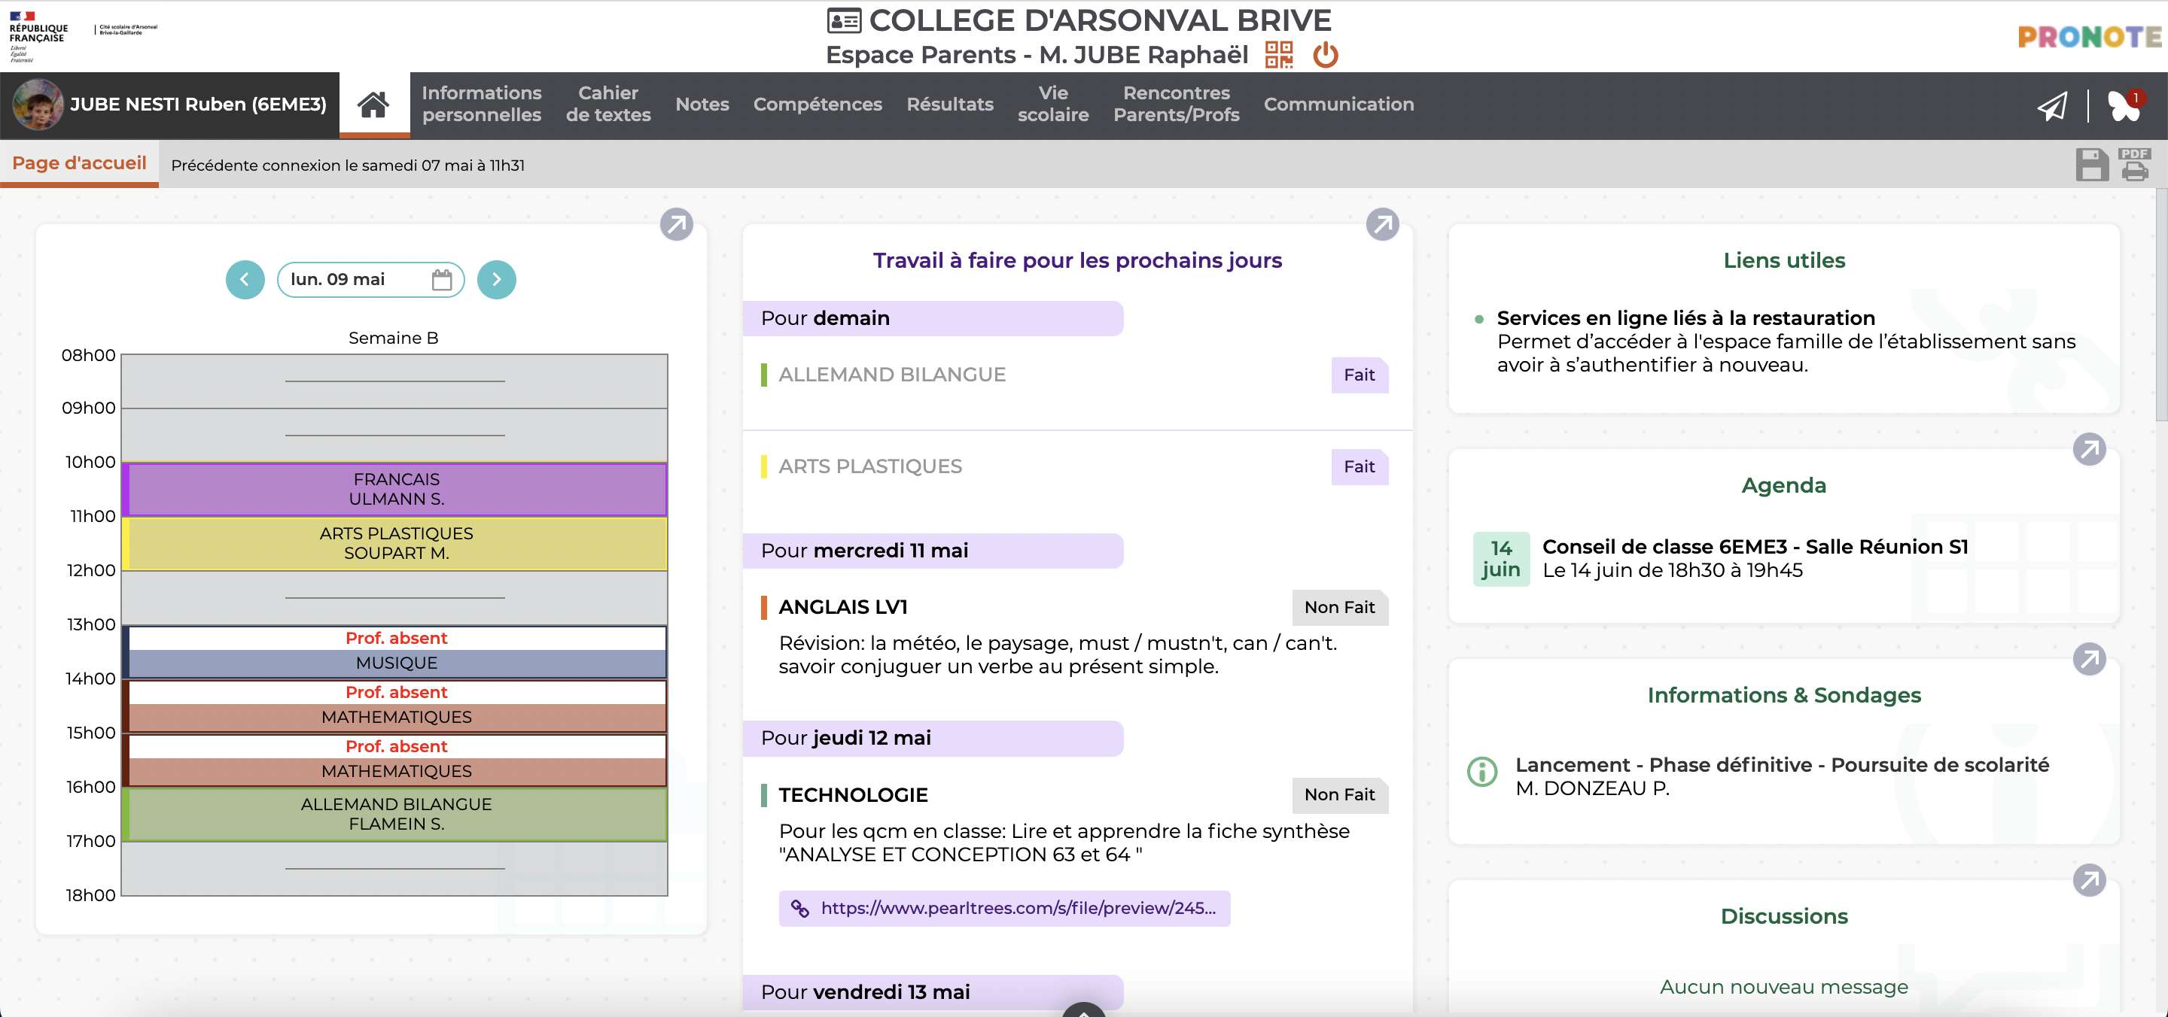
Example of a current app.

Slide 5
Solution
One app for all information, communication between pupils/parents and the administration/teacher.
Share all information and provide useful tools: agenda day-by-day, homework, communication with teachers or administration (with moderator), notes, news of the establishment,…
This app should be used in all schools: primary, middle and high school.
Can include a free video app for remote courses or meetings.
Professionals’ survey on going.
Open for new ideas!

Slide 6






Welcome on board!

